Slide 1
Trivadis Technology Radar
Guido Schmutz
@gschmutz
http://guidoschmutz@wordpress.com

Slide 2
What is a Technology Radar?

Slide 3
What is a Technology Radar?
Each of the items is classified in one of these rings:
Adopt: We can clearly recommend this technology. We have used it for longer period of time in many teams and it has proven to be stable and useful.
Trial: We have used it with success and recommend to have a closer look at the technology in this ring. The goal of items here is to look at them more closely, with the goal to bring them to the adopt level.
Assess: We have tried it out and we find it promising. We recommend having a look at these items when you face a specific need for the technology in your project.
Hold: This category is a bit special. Unlike the others, we recommend to stop doing or using something. That does not mean that there are bad and it often might be ok to use them in existing projects. But we move things here if we think we shouldn't do them anymore - because we see better options or alternatives now.

Slide 4
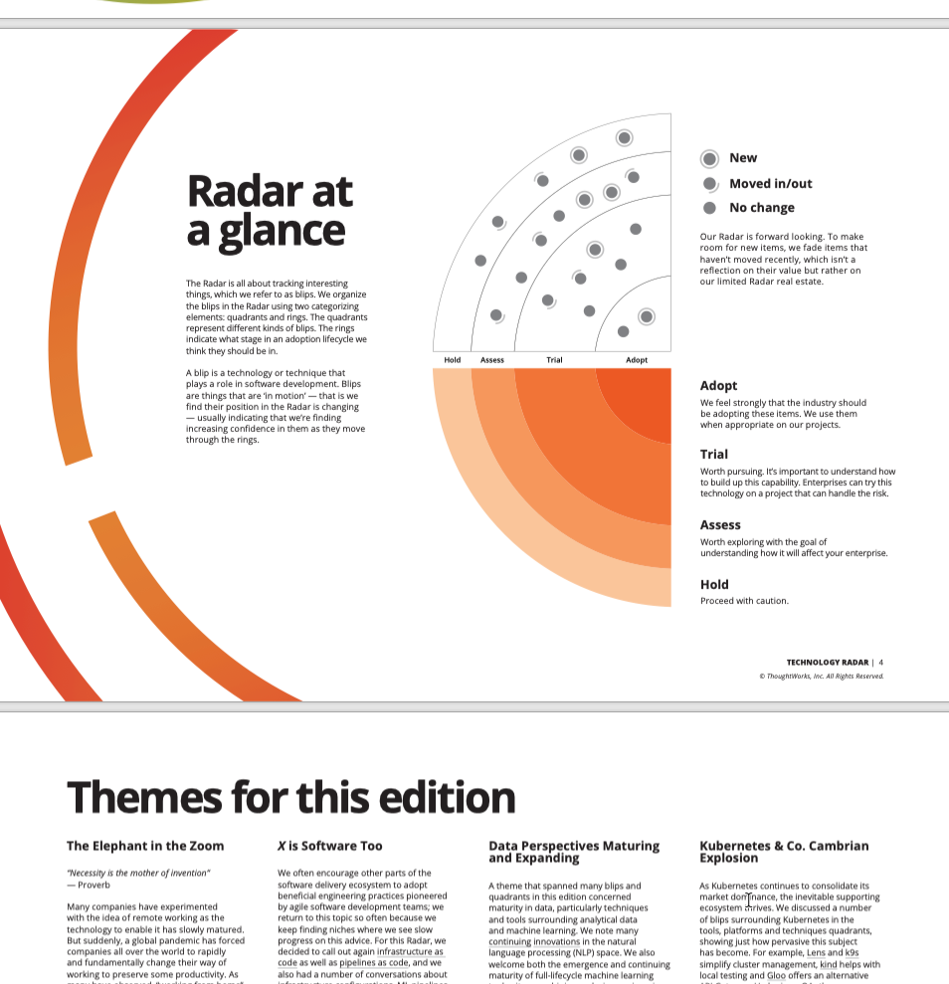
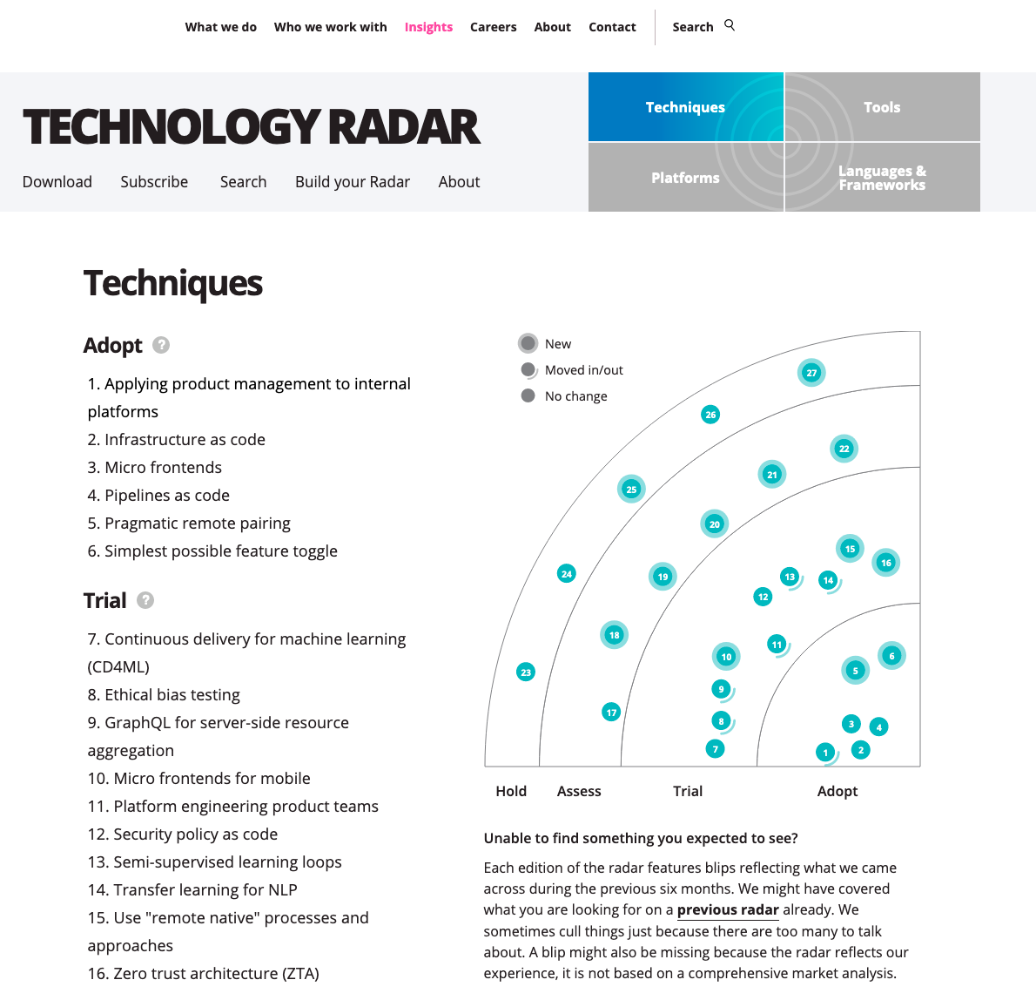
Thought Works https://www.thoughtworks.com/radar

Slide 5
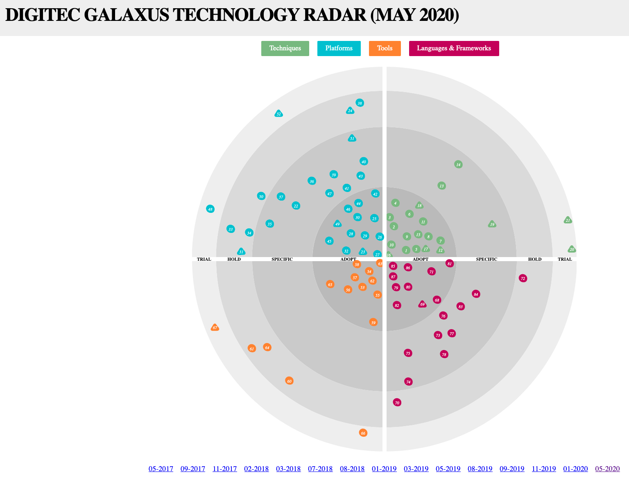
Digitec / Galaxus https://www.galaxus.ch/techradar/

Slide 6
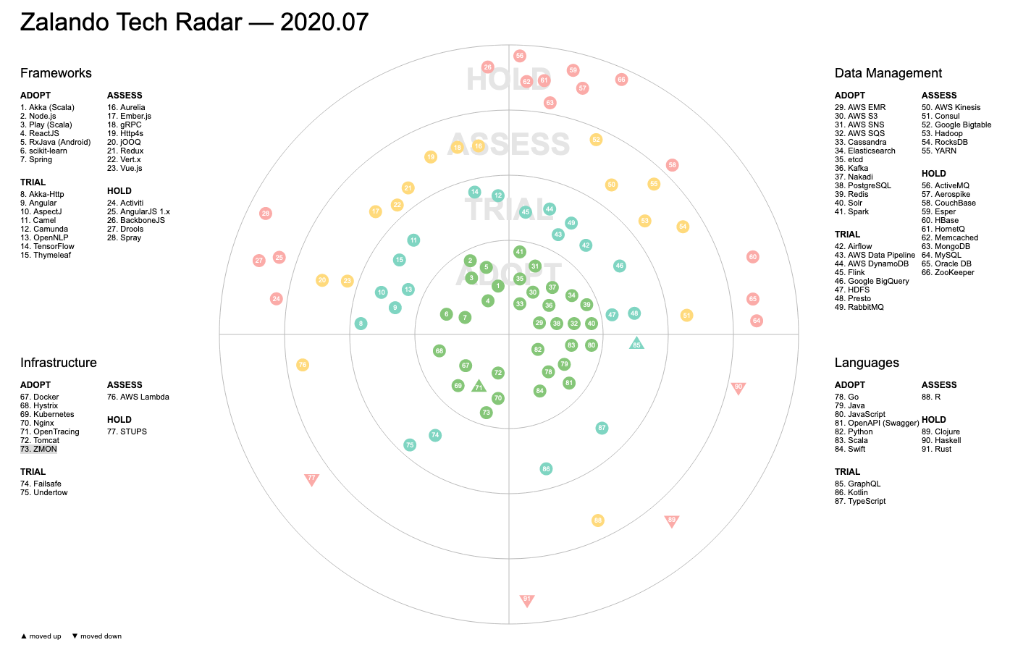
Zalando https://opensource.zalando.com/tech-radar/

Slide 7
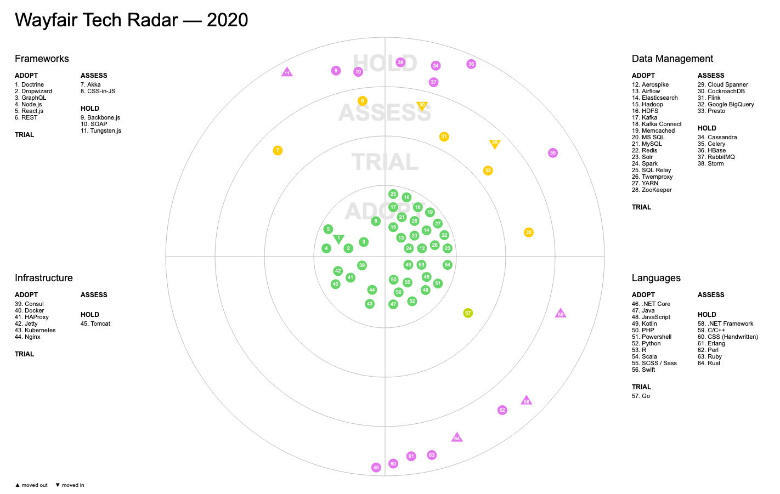
Wayfair https://storage.googleapis.com/wf-techradar-prod/index.html

Slide 8
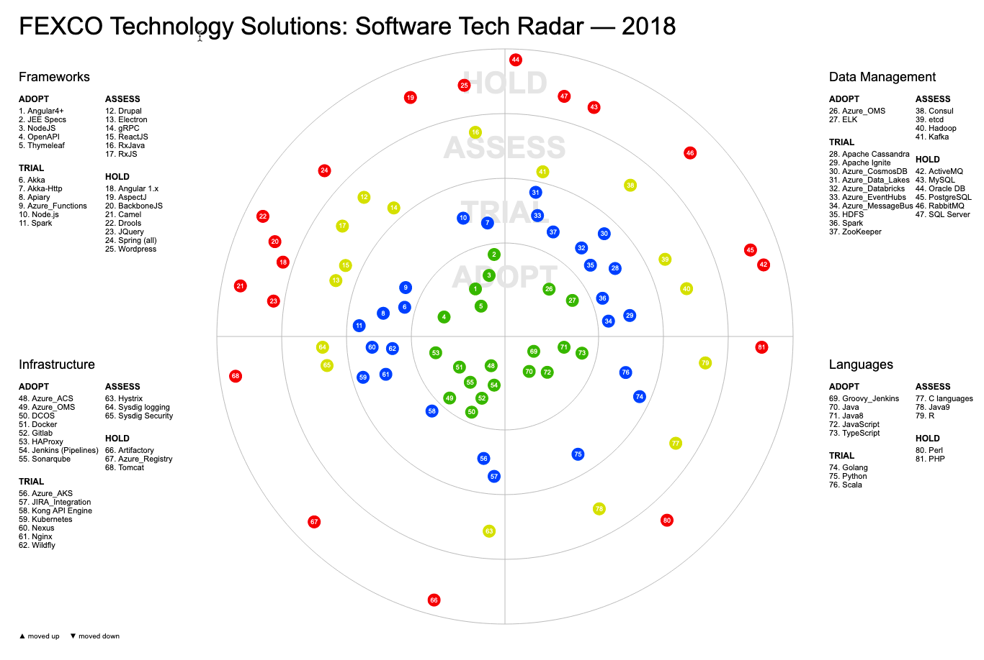
FEXCO Tech Radar https://techblog.fexcofts.com/techradar2018Q1//

Slide 9
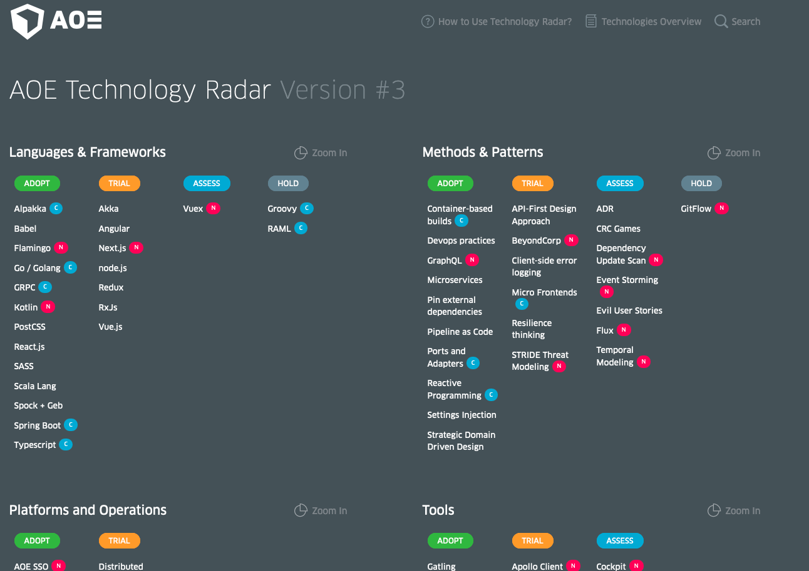
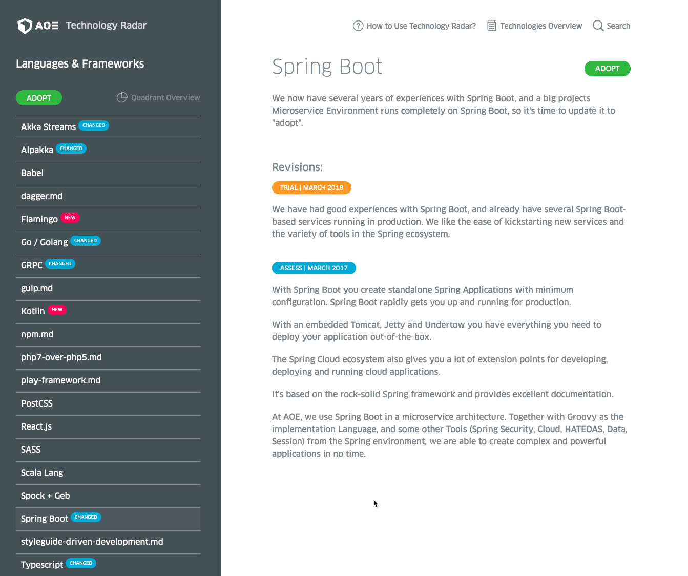
AOE Technology Radar https://www.aoe.com/techradar/index.html

Slide 10
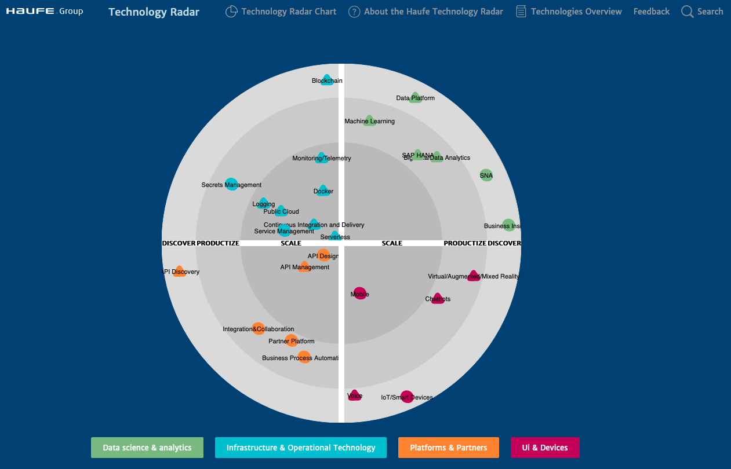
Haufe https://techradar.haufe.io/techradar/radar-chart.html

Slide 11
Trivadis Technology Radar

Slide 12
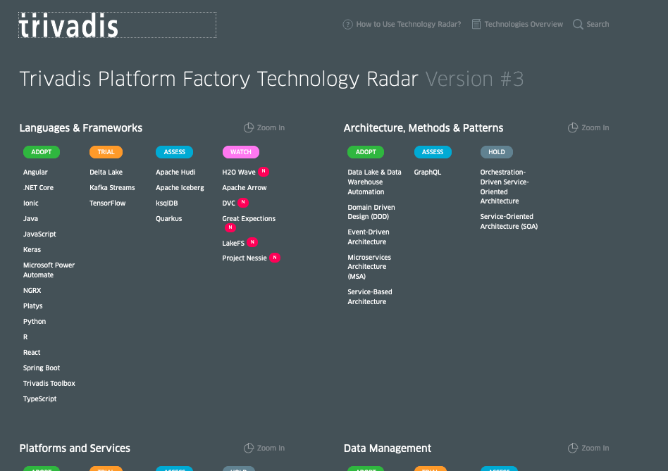
Trivadis Technology Radar
Source available in the following GitHub private repository: https://github.com/TrivadisPF/trivadis-technology-radar
Can be installed locally using docker-compose: https://github.com/TrivadisPF/trivadis-technology-radar/blob/master/deployment/README.md
Deployed on AWS Lightsail
Stable: http://3.122.200.138:28540/techradar/
Preview: http://3.122.200.138:28540/techradar/
To work on the Technology Radar, clone the develop branch of the Git project using GitHub Desktop or the command line:
git clone –-branch develop TrivadisPF/trivadis-technology-radar

Slide 13
Maintaining the Technology Radar
A technology is specified as a Markdown file, placed into one of the subfolders inside folder radar
Subfolders determine the date when the technology has been added
Each file has a front-matter header where the attributes of the item are listed
Attributes ring, quadrant and status have to be one of the values shown on the next page
---
id: react
title: "React”
info: ”a modern web framework”
quadrant: languages-and-frameworks
ring: adopt
skillsNeeded: []
relatedTo: []
alternativeTo: []
supportsTvdBB: []
owners: []
status: draft
featured: true
---
Text goes here. You can use **markdown** here.

Slide 14
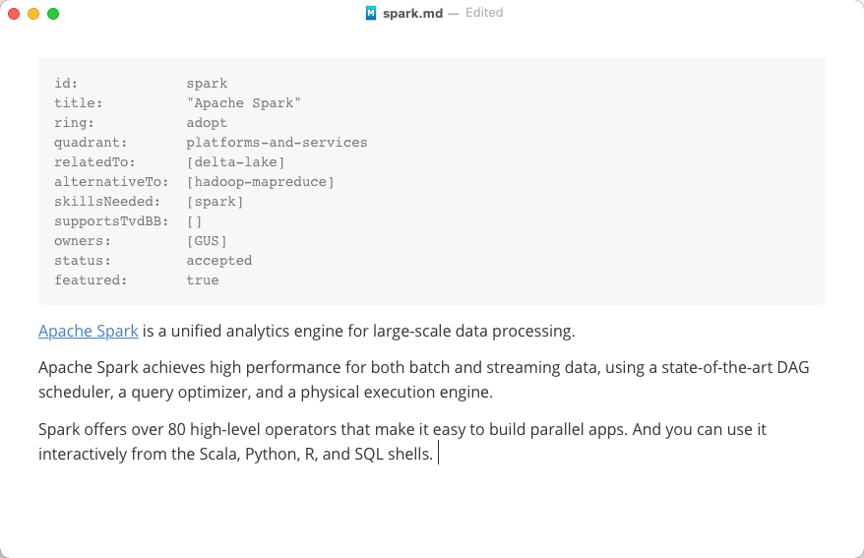
Maintaining the Technology Radar (II)
There are many good editors for maintaining markdown files, such as
https://typora.io/ (win,mac,linux)
https://macdown.uranusjr.com/ (mac)
https://wereturtle.github.io/ghostwriter/ (win, mac, linux)

Slide 15
Maintaining the Technology Radar (III)
Following front-matter attributes are possible:
id: id of the technology
title: Name of the Item
info: (optional) A short textual description of the item (visible in overview pages)
quadrant: Quadrant. One of languages-and-frameworks, data-management, platforms-and-services, architecture-methods-and-patterns
ring: Ring section in radar. One of trial, assess, adopt, hold,watch
featured: (optional, default "true") If you set this to false, the item will not be visible in the radar quadrants but still be available in the overview.
relatedTo: relates to another technology (use the id of the other technology)
alternativeTo: alternative to another technology (use the id of the other technology)
skillsNeeded: the skills needed for this technology (use the id of the skill system to refer to the skill)
supportsTvdBB: used to implement/deliver the Trivadis Building Blocks
status: status of the technology item. One of draft,proposed,rejected,accepted,deprecated
owners: the owner(s) of the technology, use the Trivadis employee abbreviations

Slide 16
Maintaining the Technology Radar (IV)
Anyone can suggest a new technology by submitting a pull-request to the folder of the next iteration
When finished, check-in the new file into GitHub and after a few minutes, it should be updated

Slide 17
Deployment of Tech Radar
Deployed on AWS Lightsail
Stable: http://3.122.200.138:28540/techradar/
Preview: http://3.122.200.138:28540/techradar/

Slide 18
Do we have one global radar or many subject based?
One base of Technology Radar Many Technology Radars
Currently we are only working on one global Trivadis wide radar
By using additional metadata we can later add different views onto the radar
Vs.

Slide 19
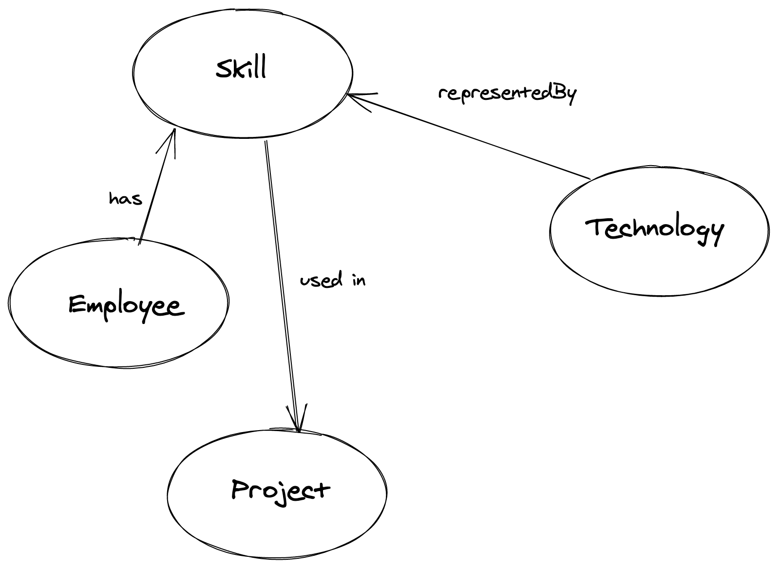
Tech Radar in context

Slide 20
Tasks – Workshop January 2021
Do you want us to build and maintain such a technology radar for Trivadis?
How often should we update it? Quarterly, every half year?
Are the quadrants the one one we want? Should we replace one by another? Should be get rid of the architecture-methods-and-patterns quadrant
Do we need multiple (layered) Tech Radars? i.e. to handle cloud technologies
Should the Technology Radar be internal or external?
What extra metadata do we want to maintain?
What technologies are missing?
Use the time to update existing technology items and add new one if necessary

Slide 21
Validation
https://www.npmjs.com/package/mwks-jsonlint
https://www.npmjs.com/package/yaml-front-matter
https://www.npmjs.com/package/frontmatter-validator

Slide 22
















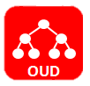












Technology Stack Data Platforms
Storage
Processing
Cloud Computing
Container & (Development) Automation
Security
Notes:
English version

Slide 23


